Slide 1
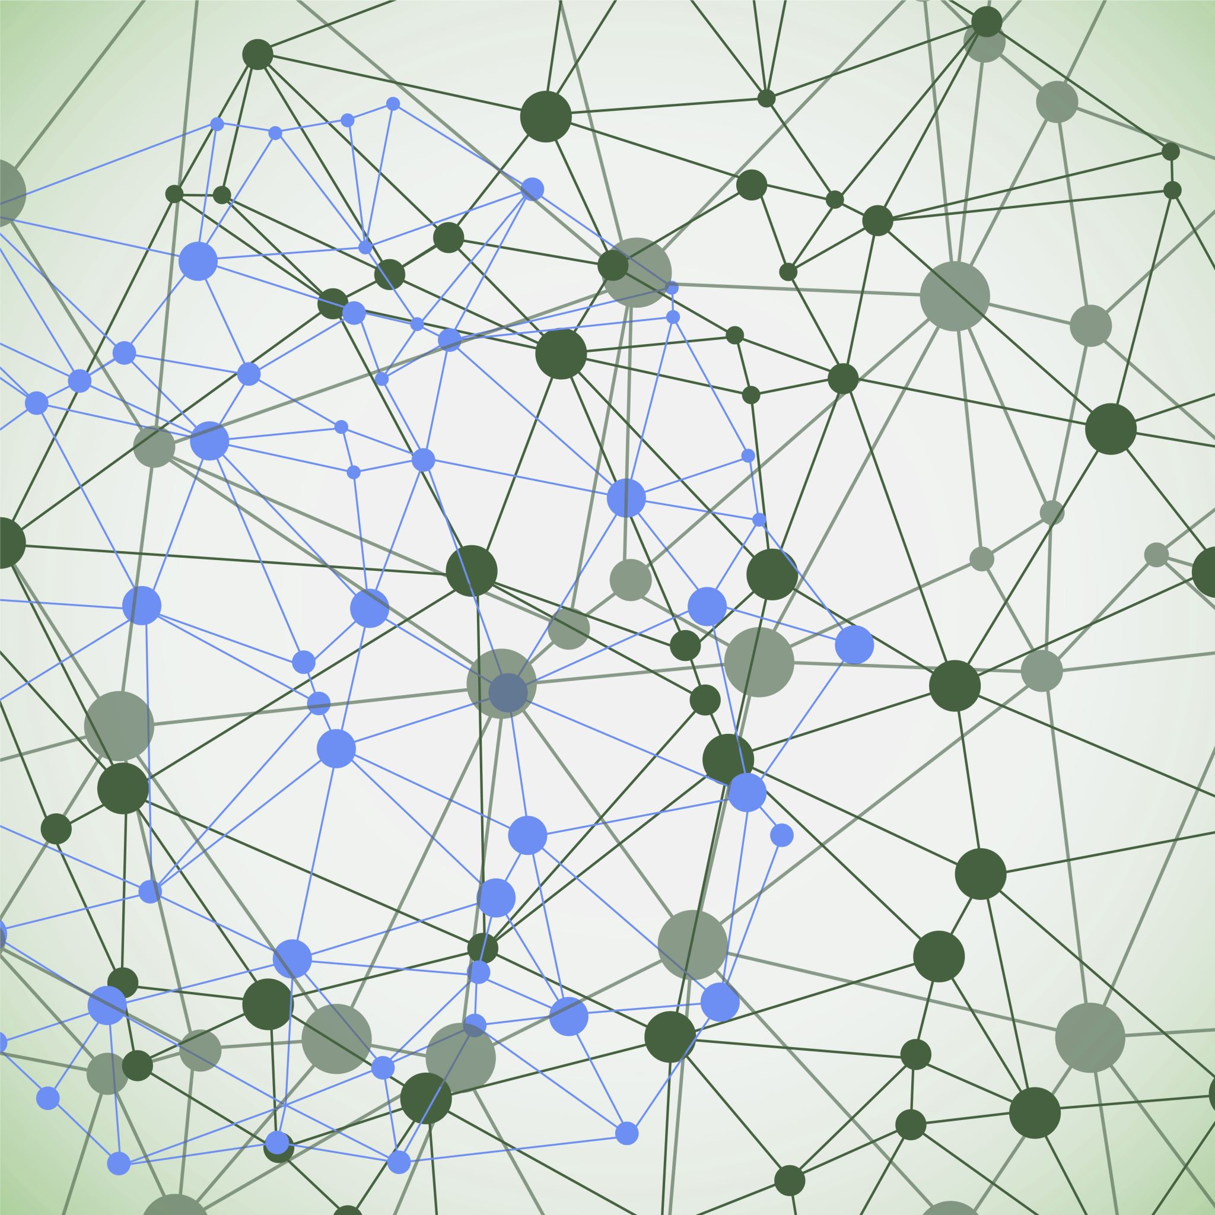
Conflict: what is it, how to understand it, ideas for organizing it.

Slide 2
Julian’s Definition of Conflict
Disagreement between two or more interdependent parties who act based on perceived incompatibility of their objectives.

Slide 3
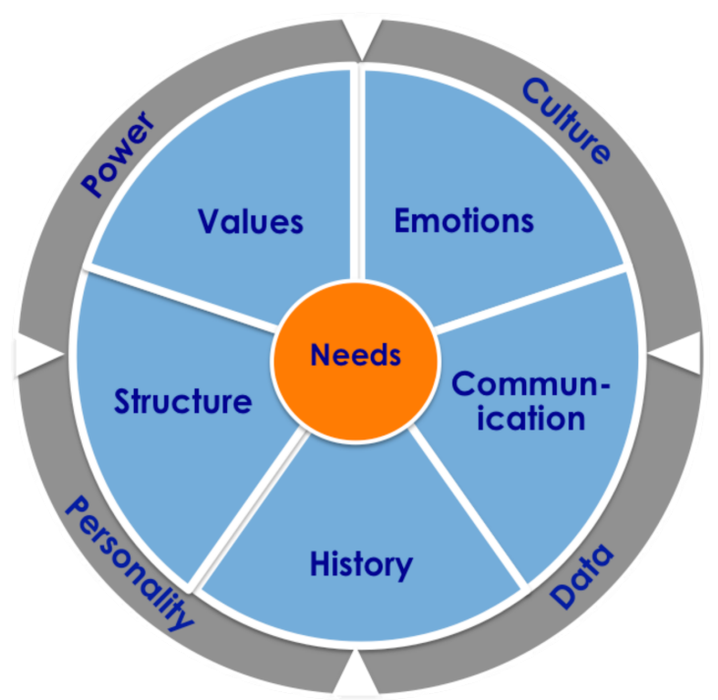
Perception
Behavior/action

Slide 4
Perception
Comes from
Affects
Culture
Education
Experience
Outside information
Religion
How we see one another
Interpretation of events and/or facts
Tightly related to emotions: two-way street.
Same fact can be seen over time differently.
Always biased: attribution bias/confirmation bias.

Slide 6
Naïve Realism
I see reality, and my actions and beliefs are based on a rational interpretation of reality.
Other rational people see things as I do.
If others don’t share my views, its because they are:
Crazy (non rational)
Stupid
Trying to fool me
Notes:
6

Slide 7
Emotions
We feel based on what we perceive.
We perceive based on what we feel: confirmation bias/affirmation bias.
SO much information.
Tend to elicit reciprocity.
We have different tolerances for emotional severity.
Emotion and feeling come first, THEN rational thought.
As intervenors:
Need to find the right balance of emotion.
They signal what’s important for people. They should guide inquiry.
CANNOT ask people to put them aside.
Notes:
Silke Hansen of the Community Relations Service of the Justice Department tells the story of the Native American negotiators speaking with the US Government about a treaty that involved both land and water…she needed more emotions.

Slide 8
Communication: Axioms
I. It is impossible NOT to communicate.
II. All communication has content meaning as well as relational meaning.
III. The nature of a relationship depends on how the communicators define the sequence and start of communication.
IV. Meaning is assigned by the listener NOT the speaker
Fundación Cambio Democrático - © 2001 – Fisher, Roger, and William Ury. Getting Past No. Random House Business Books, 1992.

Slide 10
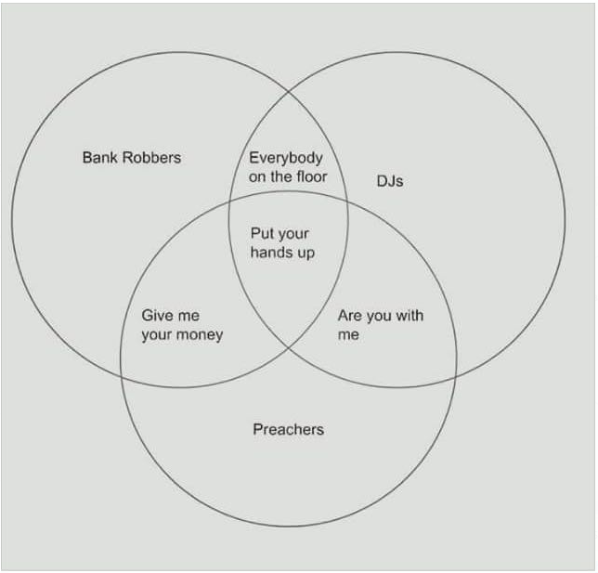

Slide 11
Relationship V Substance
Substance
Relationship

Slide 12
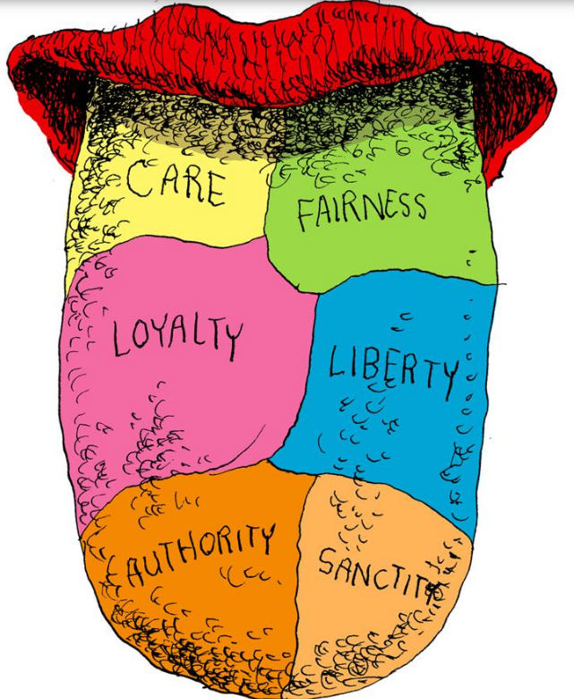
Moral Pillars: Jonathan Haidt

Slide 13
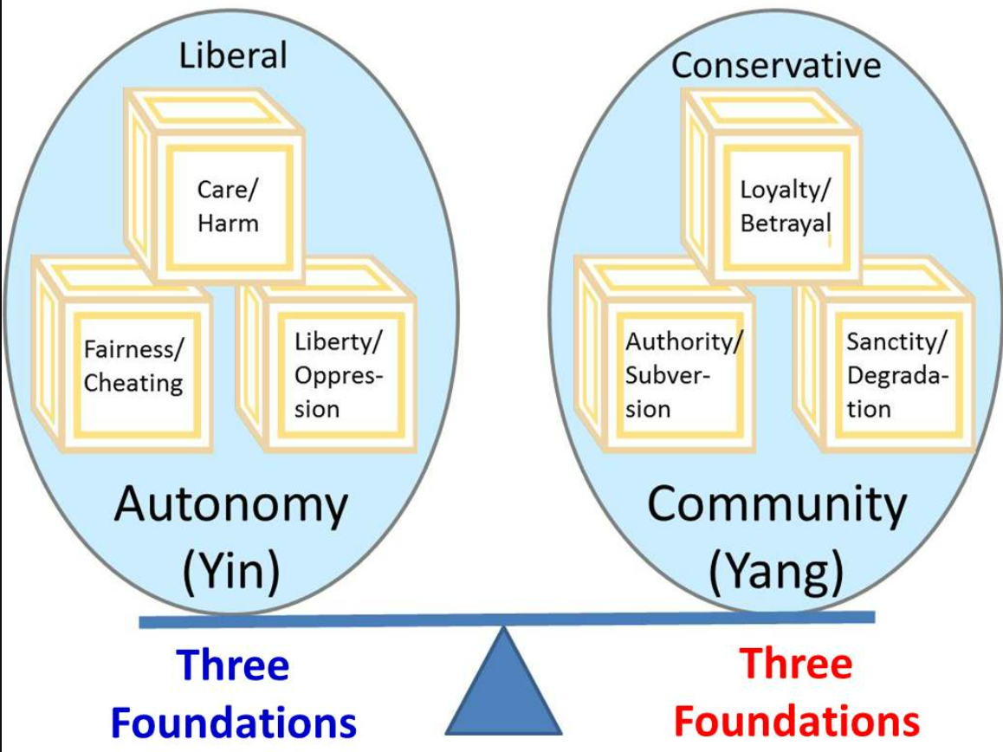
Pillars of Moral Decision-Making according to political affiliation.

Slide 14
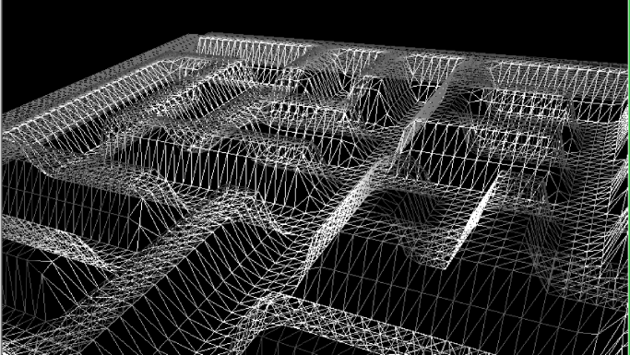
Structure
Notes:
Plays everywhere but especially in organizational development: Structures make people do things regardless of who they are. Working on a strategic planning retreat for the UNDP in Mexico, things between staff were tense. You had program people / financial and / admin people and leadership.

Slide 15
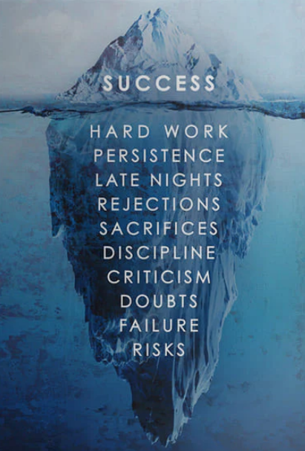
History
Apparently outsized reaction to something at family dinner
Snide comment last summer by brother
Bitter divorce and fight over custody
Alcoholism
Old debate about who mom paid more attention to
Sports star v bookish introvert
Notes:
True in families ALWAYS. But it’s also true in political conflicts, organizational conflicts and in any conflict that is in a specific place with specific people.

Slide 16
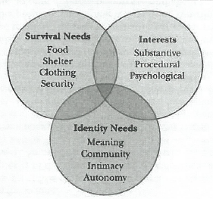
Notes:
Seems simple enough, but if you’re not on the same page, it can have major consequences and people can be talking at cross purposes with one another. Jayne Docherty at EMU (New Yorker) talks about the Branch Dividians at Waco negotiating with the FBI…Too deep or not deep enough

Slide 17
Problem: substantive interests
Intervention triangle
Process: how to talk about it / history of talking about it
People/relationships/psychological needs

Slide 18
Conflict Styles
Accomodate
Collaborate
Compromise
The Needs of the Other
Compete
Avoid
My needs

Slide 19
Power, Rights and Interest-based approaches to conflict
POWER
POWER
EFFECTIVE
System
RIGHTS
INTERESTS
RIGHTS
DISTRESSED
System
INTERESTS

Slide 20
Continuum exercise
Notes:
Weather, how far away is the place you call home,
Thinking and processing out loud with others v thinking quietly and alone, then over there
Big picture v details
Problelm solving v how people are feeling in the room
Worried about endless conversation that will circle and circle v worried about leaving out a key perspective that can change things up

Slide 21
Conflict Resolution Methods

Slide 22
Conflict Resolution Continuum
Third party role
Voluntary participation
Party’s control over solutions
Satisfaction level
Direct communication
Relationship between parties

Slide 23
Bernie says
As we develop our ability to understand conflict in a deeper and more powerful way, we enhance our ability to handle it effectively and in accordance with our deepest values about building peace.

Slide 24
Basic Ideas
Conflicts are a normal consequence of human interaction.
They can be constructive forces for social change.
Conflict resolution should not be an effort to suppress conflict but rather an effort to focus conflict energy through constructive channels.

Slide 25
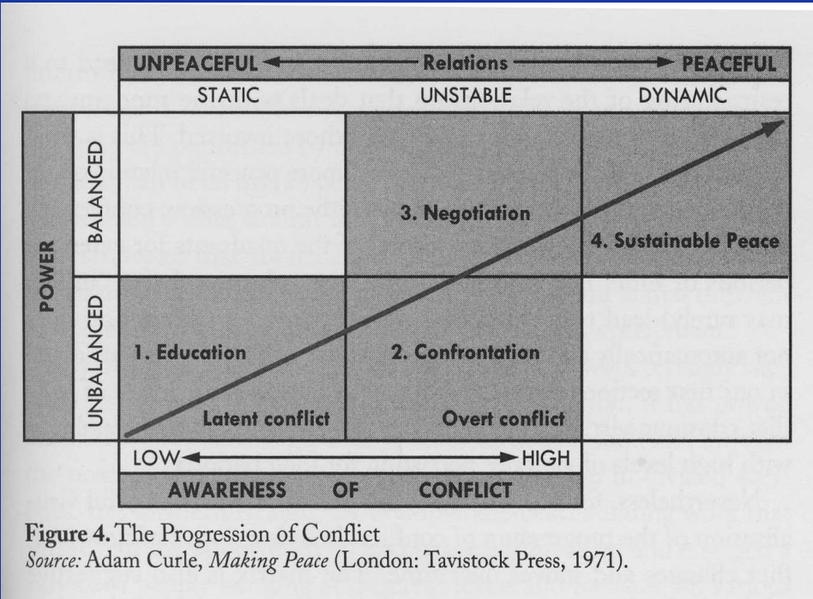

Slide 26
