Slide 1
Conflict Transformation at Many Levels
Bruce W. Dayton, PhD
Director, CONTACT Peacebuilding Program Associate Professor, Diplomacy and International Relations School for International Training

Slide 2
Core Ideas in Conflict Transformation
Conflicts are inevitable and essential across all levels of human interaction (from interpersonal to international).
We will never create a conflict-free world (nor do we want to).
Thus, the goal of conflict transformation is to build communities that manage conflicts in ways that are more constructive and less destructive.

Slide 3
How do we begin?
Thought exercise
Conflict transformation starts with good analysis. It requires a capacity to understand the multiple drivers of conflict, which are most salient, how they intersect, what interventions by what actors at what points in time are likely to work, and why.
This is the ultimate interdisciplinary challenge: Ukraine.

Slide 4
Conflict analysis and transformation: a useful analytical framework
Positions
Structures
Cognitions
Four drivers
Four lenses
Emotions

Slide 5
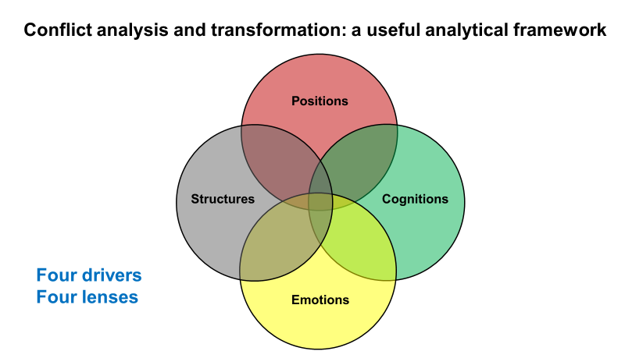
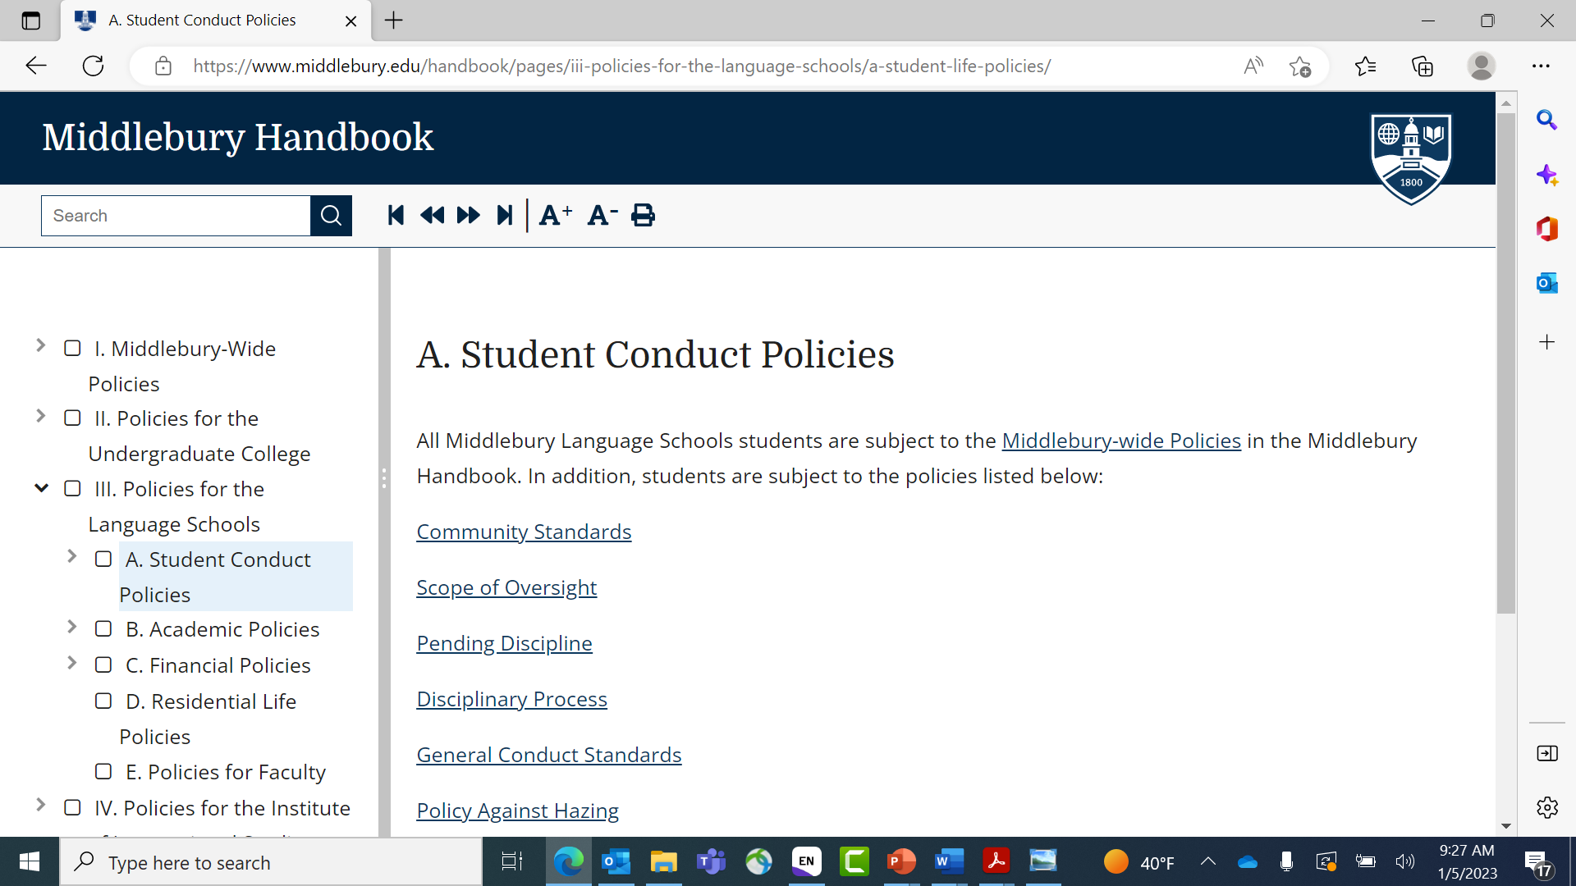
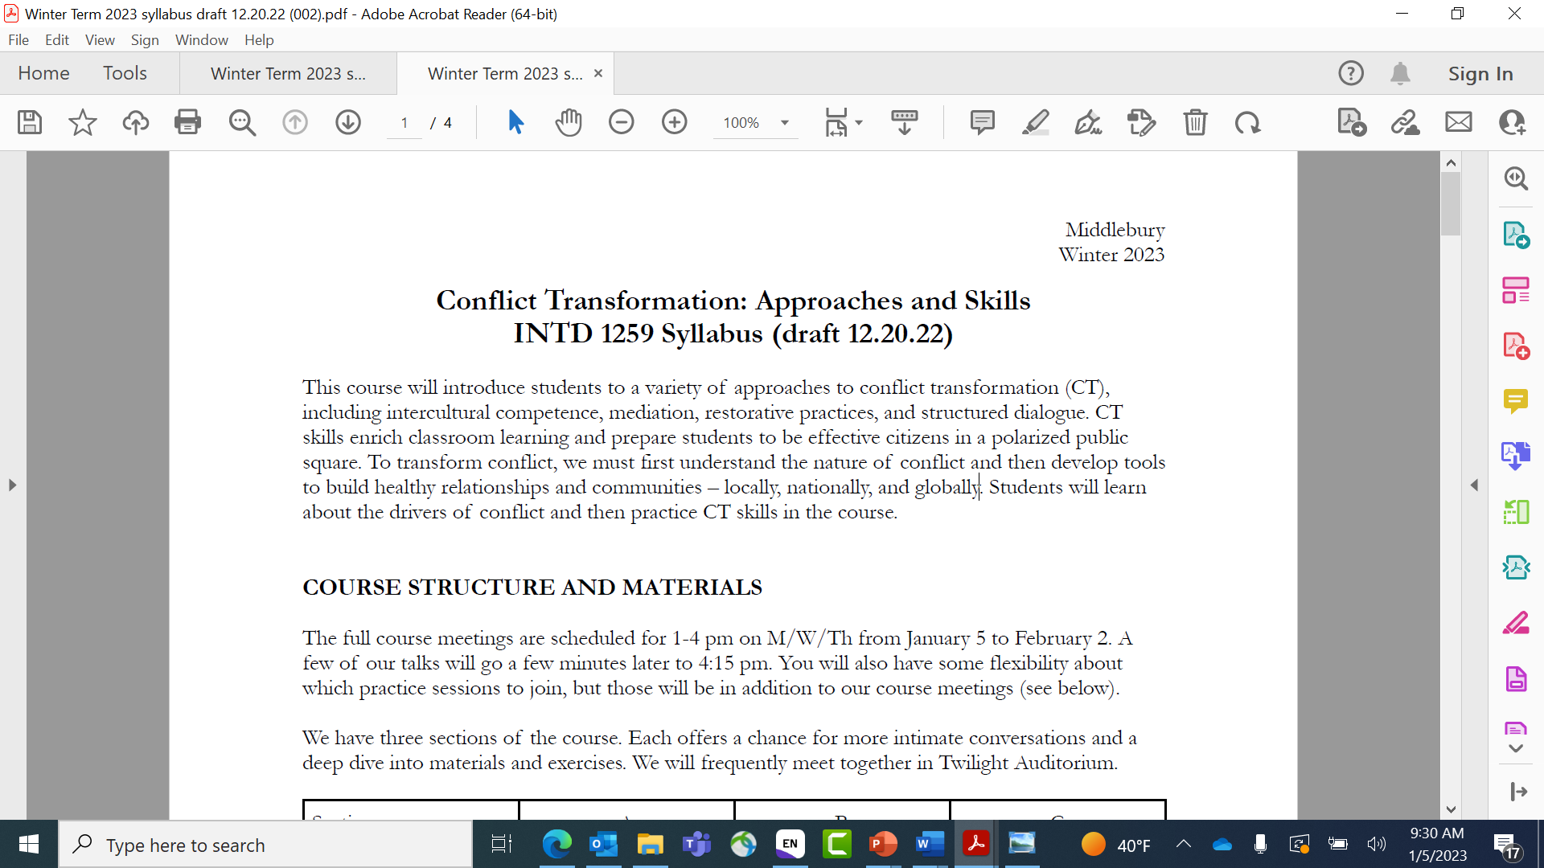
Lens 1: Structures

Slide 6
Lens 2: Cognitions World View Cognition Narrative Lens Script Frame Construct Assumptive World Culture Identity Meaning Making
Event
Ac
T
i
on

Slide 7
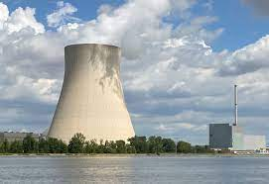
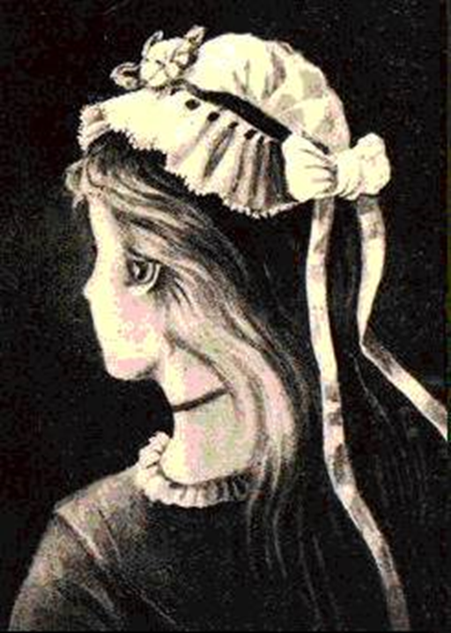
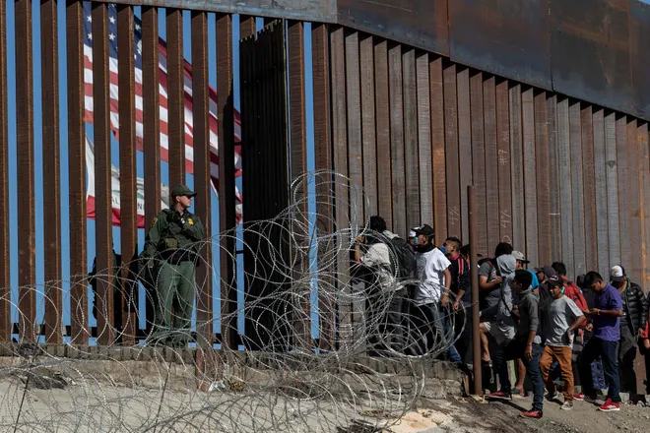

Slide 8
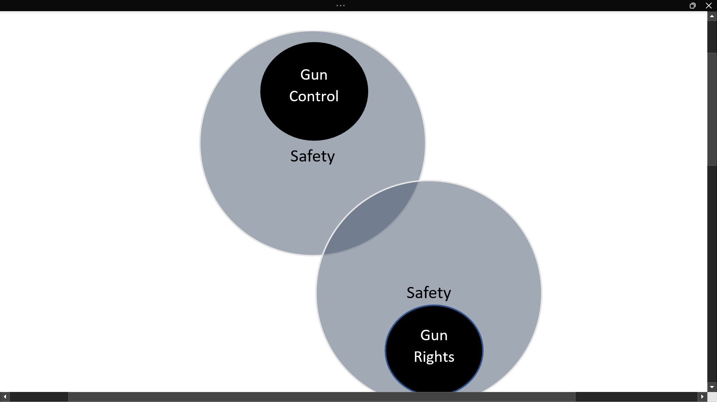
Lens 3: Positions
Positions verses interests

Slide 9
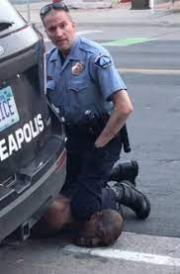
Lens 4: Emotions

Slide 10
 | Structures | Cognitions | Positions | Emotions
Key Concern | How power, privilege, access, and resources are distributed and maintained by social and political institutions. | How beliefs, worldviews, identities, and narratives about self and other shape the conflict landscape. | How the tangible things that people want (the goals they set) can results in zero-sum conflict outcomes. | How fear, loss, grief, humiliation, rage, and other emotional dynamics perpetuate the conflict cycle.
Targets for Transformation | Laws Rules Norms Policies Institutions | Social-psychological dynamics such as stereotyping, dehumanization, negative attribution. | Framing of goals | Intense emotional states suffered by those victimized by conflicts.
Means | Social movements (peace pushing) Vote, run for office, policy advocacy Non-compliance | Dialogue Discourse People-to-people exchange | Interest-based negotiation Third party intermediaries | Trauma-care Restorative practice Reconciliation initiatives Rituals

Slide 11
Which Perspective Offers the Most Explanatory Power?

Slide 12
Tabletop exercise
Select a conflict (campus, national, international)
Apply the analytical framework (incompatible positions, incongruent cognitions, emotional response, structural inequality).
What conflict transformation practice might follow from your analysis?

Slide 13
So, you want to be a passionate advocate for conflict transformation?
Practice analyzing every conflict through multiple lenses.
Base your interventions on the most salient drivers – or those that must be attended to first.
Learn the skills: Dialogue, negotiation, mediation, conflict mapping, restorative practice, trauma informed practice, power analysis, containment, deep self-examination.

Slide 14
Discussion

Slide 15
